Slide 1
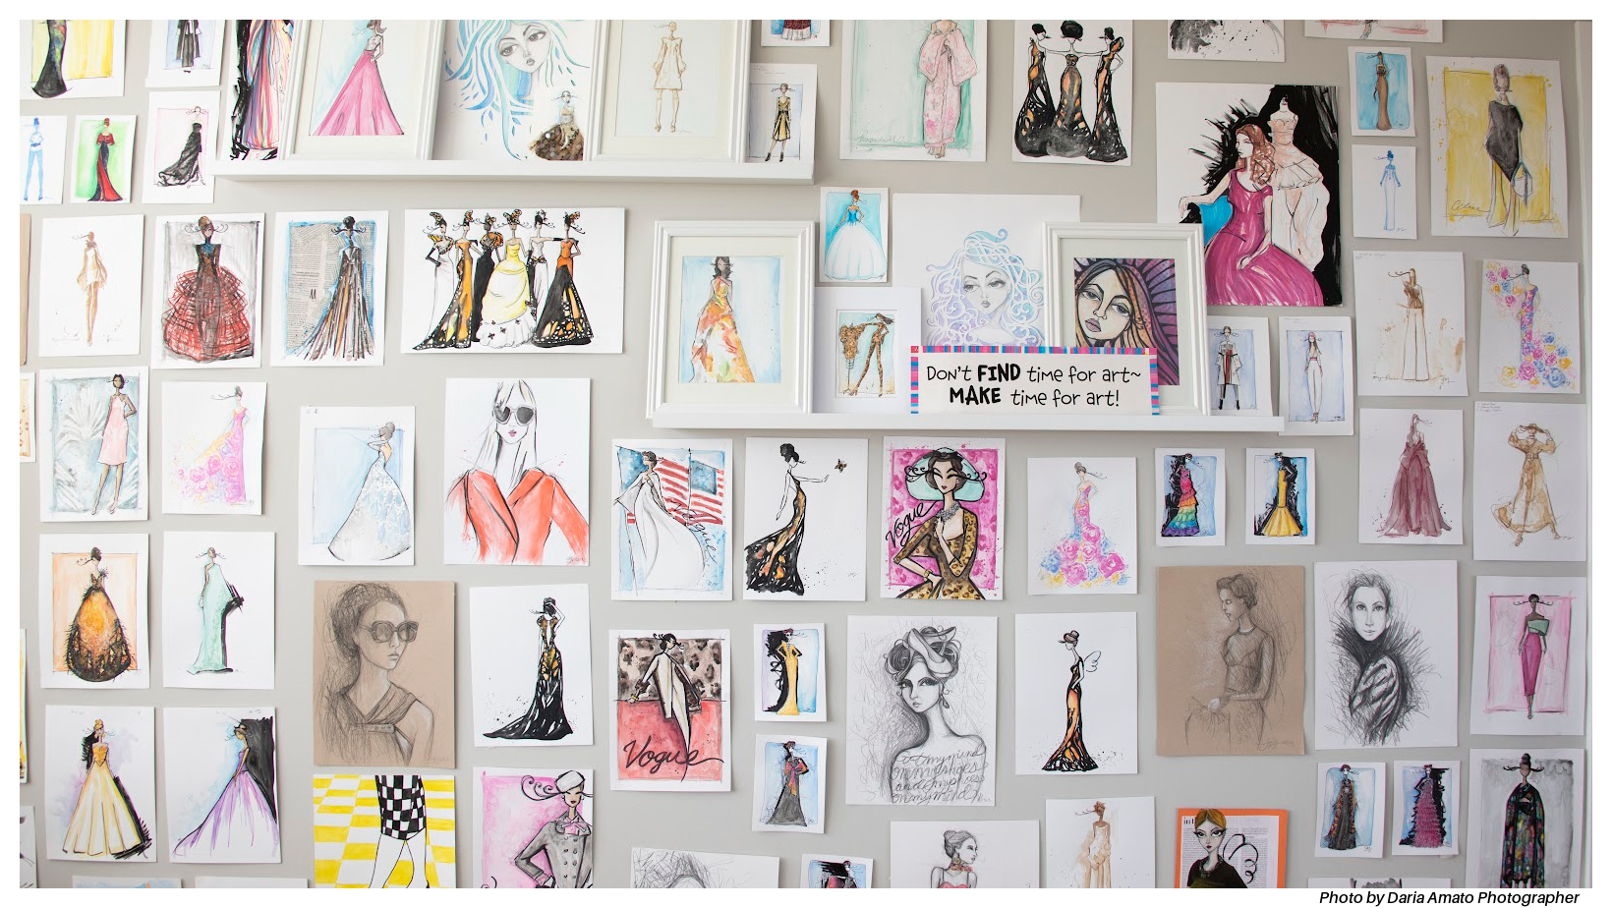
Create EVERY day.
ECU Art Education Guild Presentation, Part 1
Jennifer Love Gironda, MAEd/NBCT

Slide 2
Hi, I’m Jenny!
BFA, East Carolina, 2001 (Art Education/Textiles)
MAEd, East Carolina, 2009 (Art Education/Textiles)
National Board Certified Teacher, Early/Middle Childhood
19th year as an art teacher (have taught all grades, K-12)
Recognitions include Teacher of the Year, Palm Beach County Muse Award, FAAE State Teaching Artist Residency

Slide 3
In 2012 I decided to make art. EVERY day.

Slide 4
…and I did. December 31st, 2021 was my 3,653rd consecutive day of creating art every single day.

Slide 5
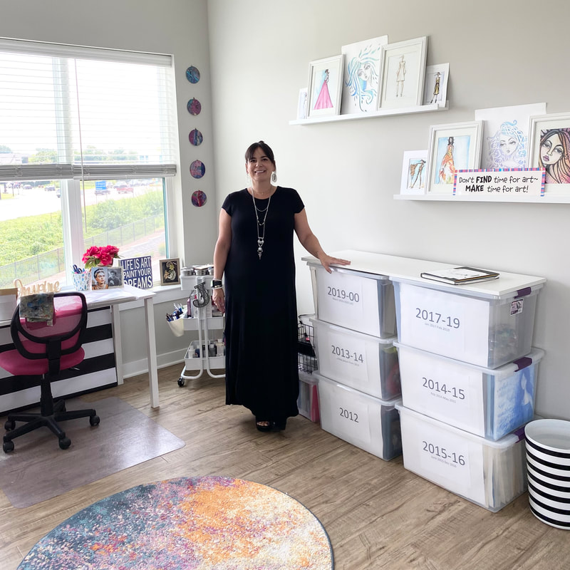

Slide 7
“Don't think about making art, just get it done. Let everyone else decide if it's good or bad, whether they love it or hate it. While they are deciding, make even more art.” -Andy Warhol

Slide 8
Why? Because YOU are an artist. It is good for your mental health. It will make you a better teacher.

Slide 9
Goals Short Term Goals. Long Term Goals. BIG FAT DREAMS!

Slide 10
Inspiration Themes/Subjects/Materials Inspiration Board/Sketchbooks

Slide 11
“You can't use up creativity. The more you use, the more you have.” -Maya Angelou

Slide 12
Space Size doesn’t matter. ‘Studio on the Go’ The importance of Planning

Slide 13
Organize Planning (yes, again.) Documentation. Inventory and Storage.

Slide 14
Resources On-line Challenges. Local Groups.

Slide 15
Obstacles Time. Space/Resources/Materials. Size. Haters. …and YOU. Yup, you.

Slide 16
How will you maintain your artistic practice once you start teaching?

Slide 18
…now make it fashion.
ECU Art Education Guild Presentation, Part 2
Jennifer Love Gironda, MAEd/NBCT

Slide 19
‘My ‘Ah-ha Moment’
…I discovered I really enjoyed sketching fashion and there was a name for it-
Fashion Illustration. I am obsessed.

Slide 20
https://www.masterclass.com/articles/what-is-a-croquis-learn-how-to-draw-croquis-with-detailed-step-by-step-guide

Slide 21
‘Werrrkkshop’
Today we will create a croquis and then ‘dress it’ using mixed media.

Slide 22
Fashion in the Classroom.
…I include my love for fashion in my teaching. Here are some pics!

Slide 23
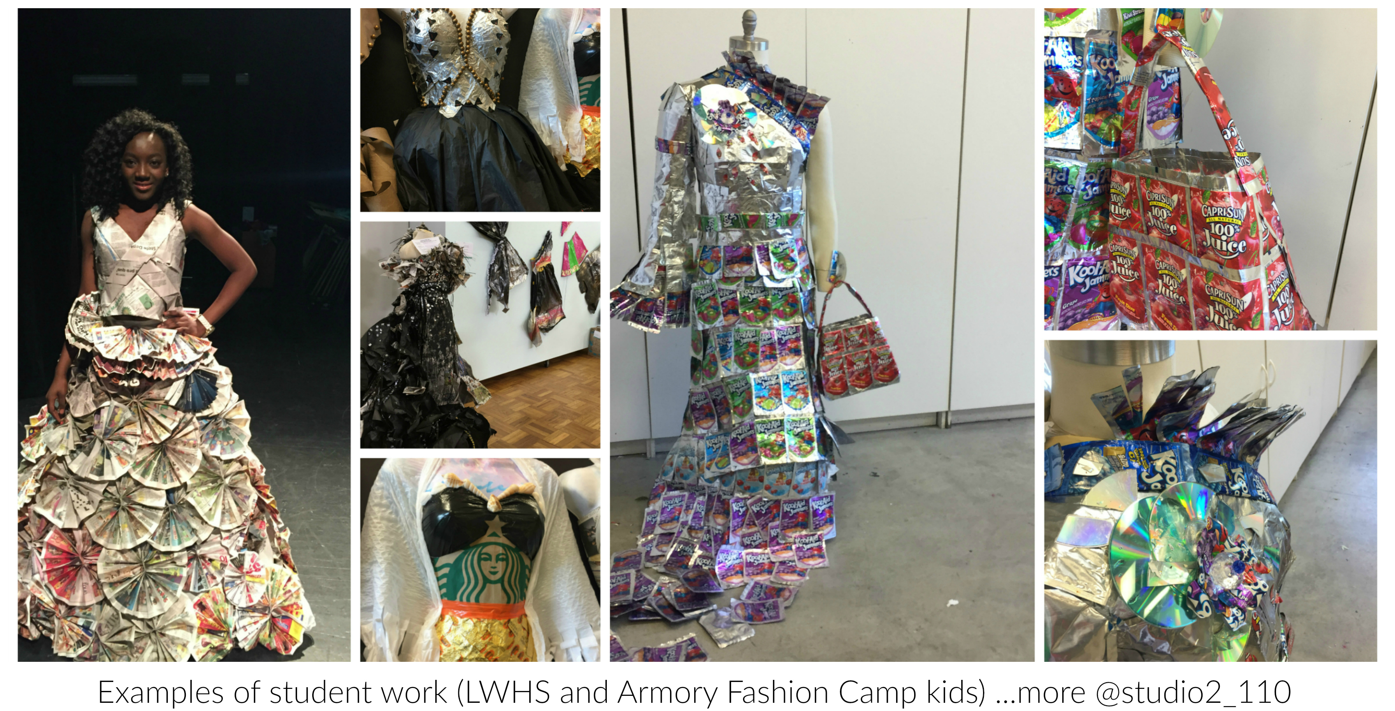

Slide 24
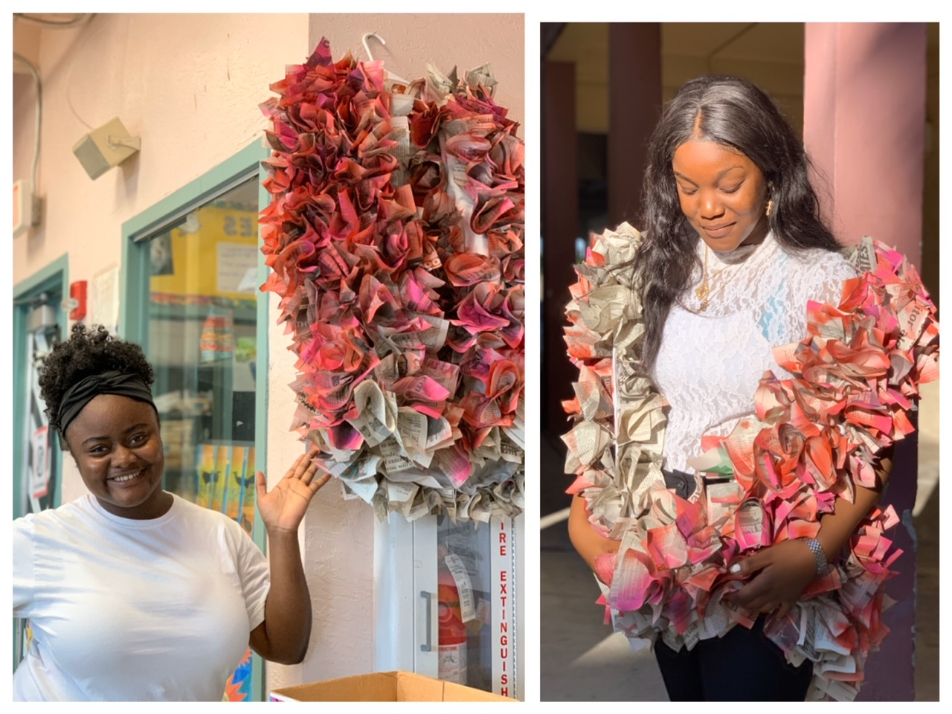

Slide 25
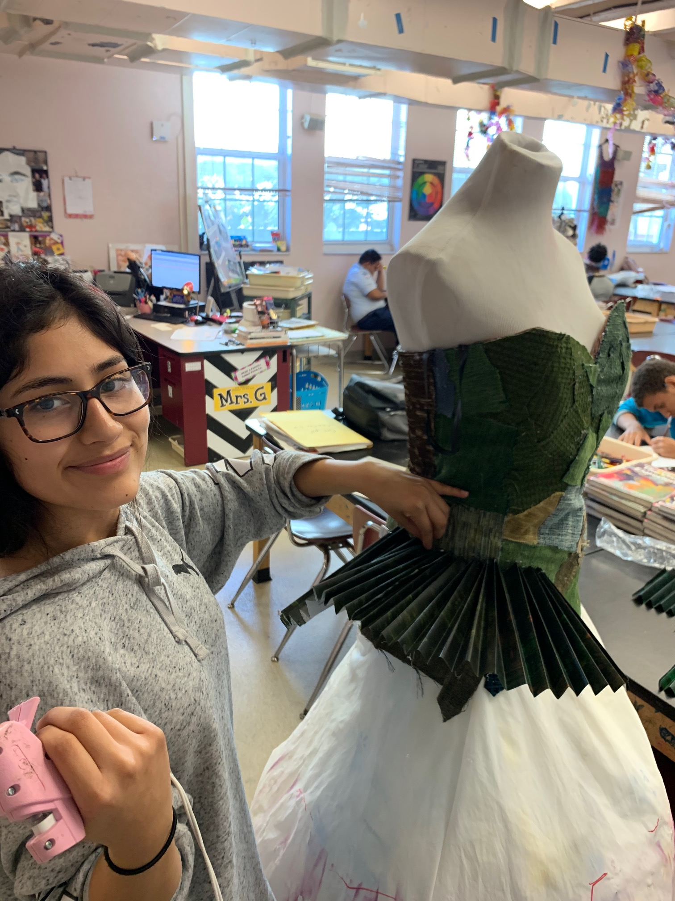
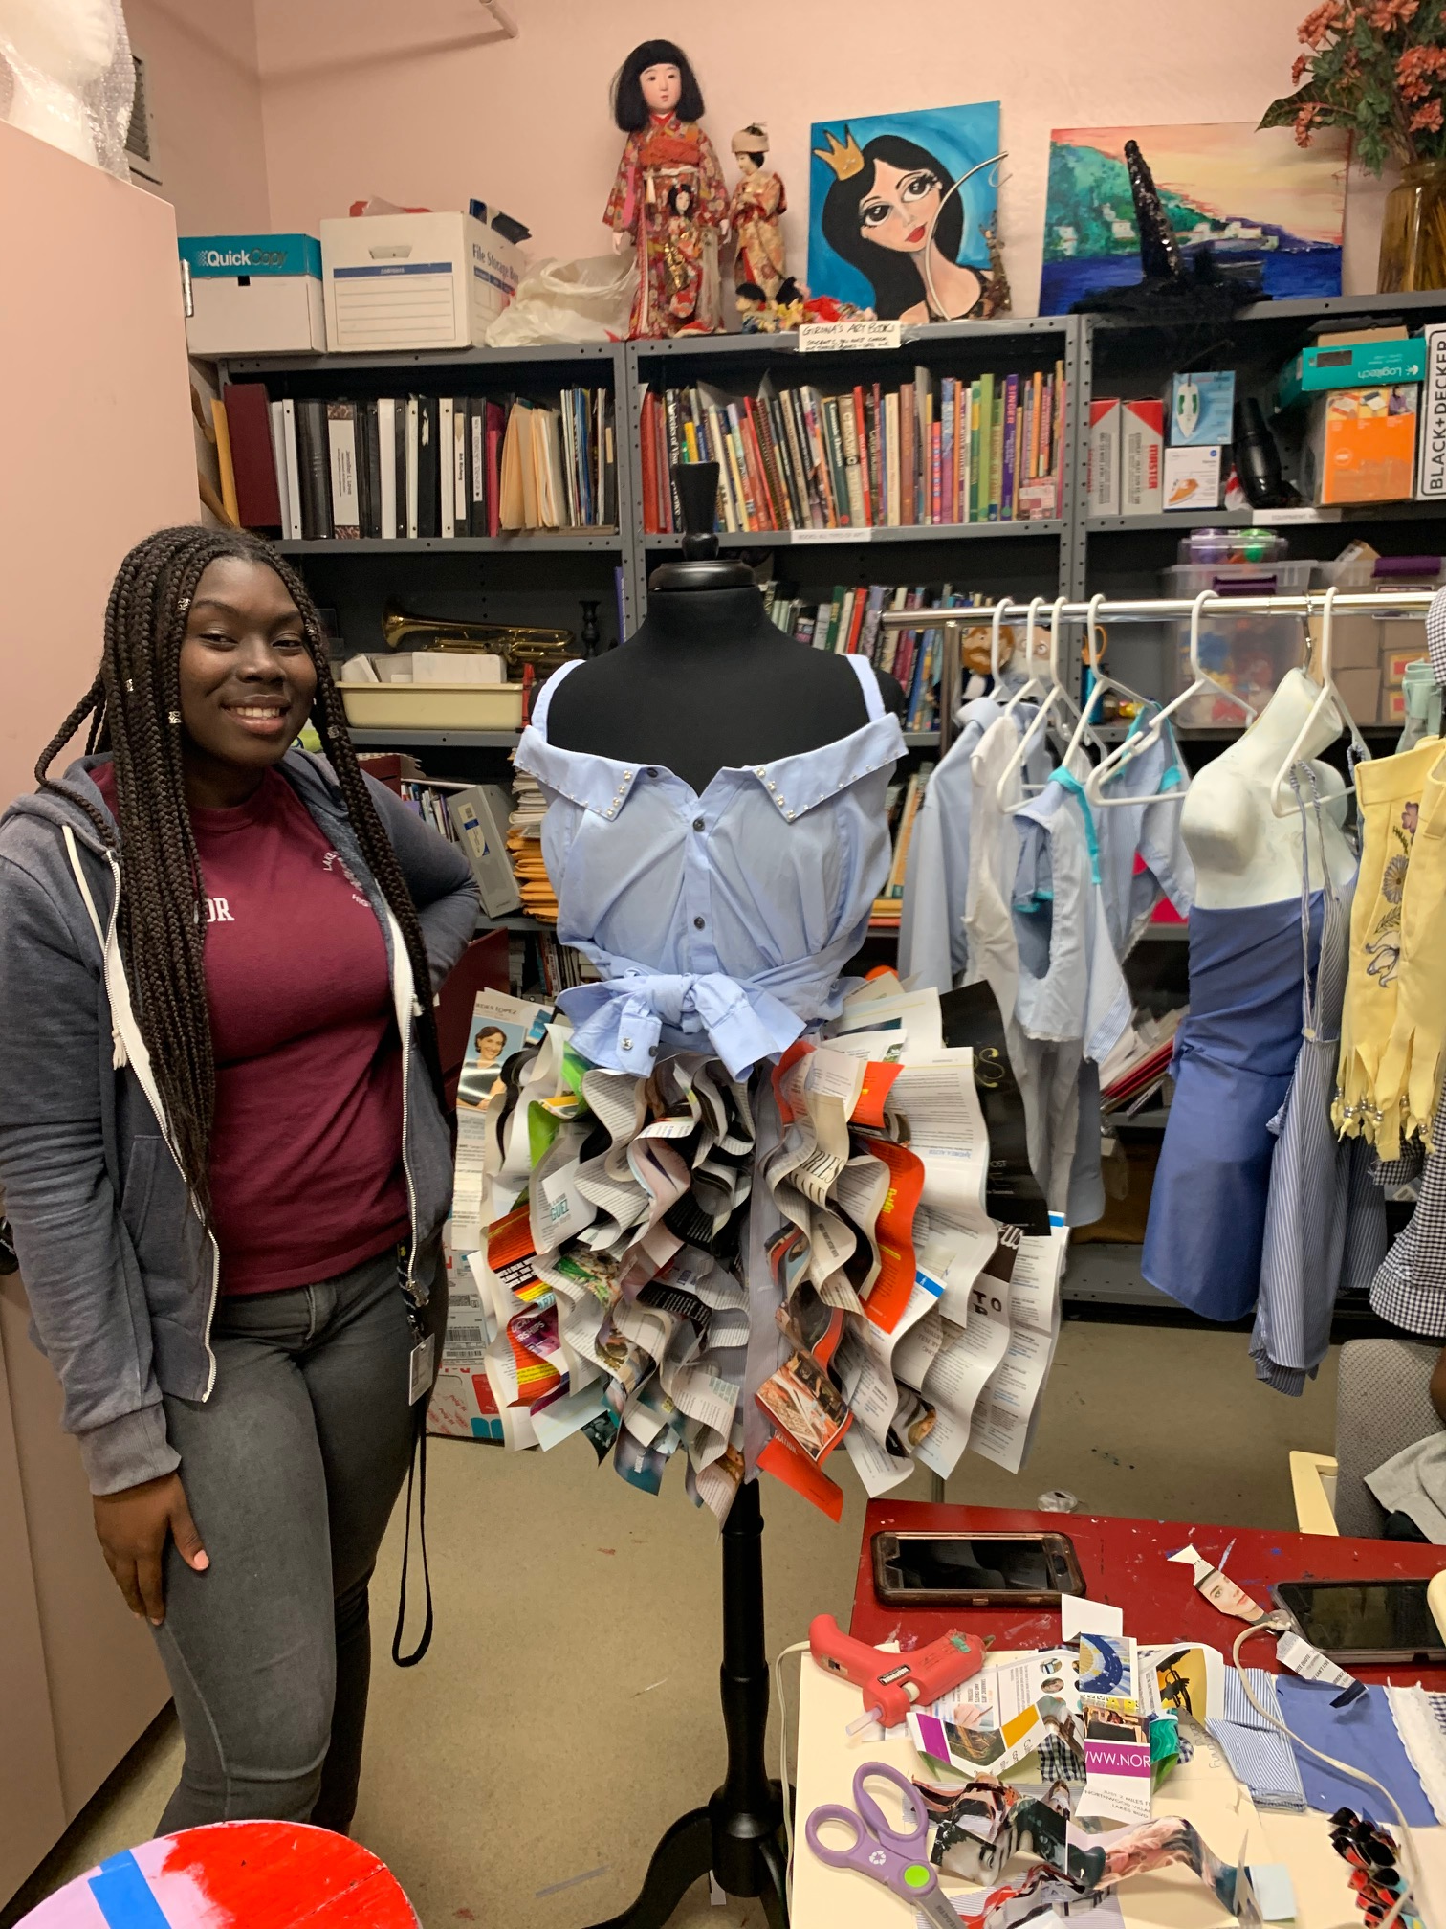

Slide 27
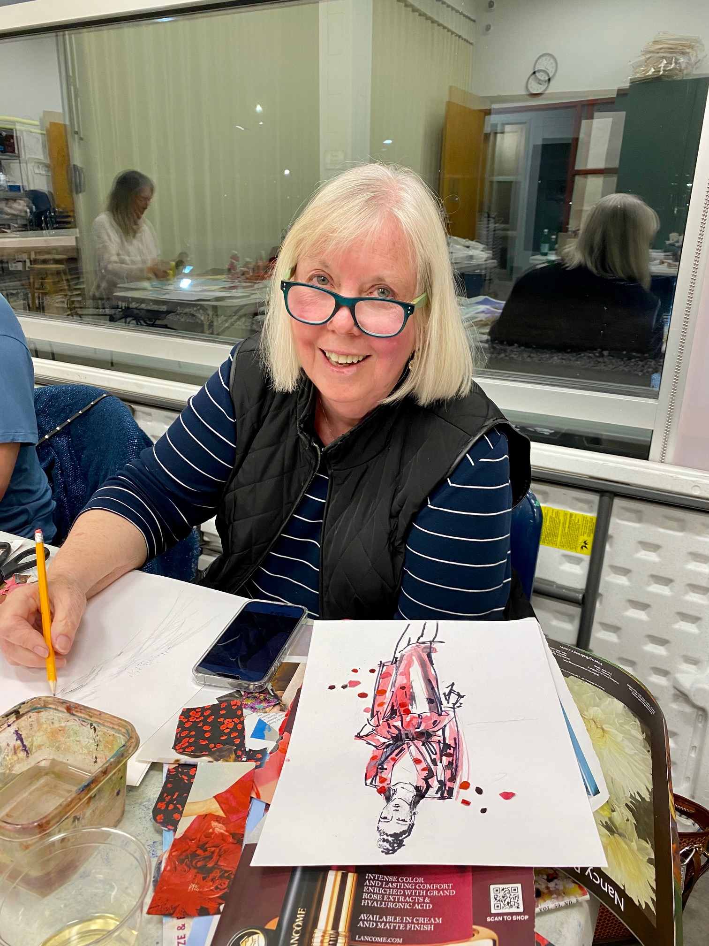
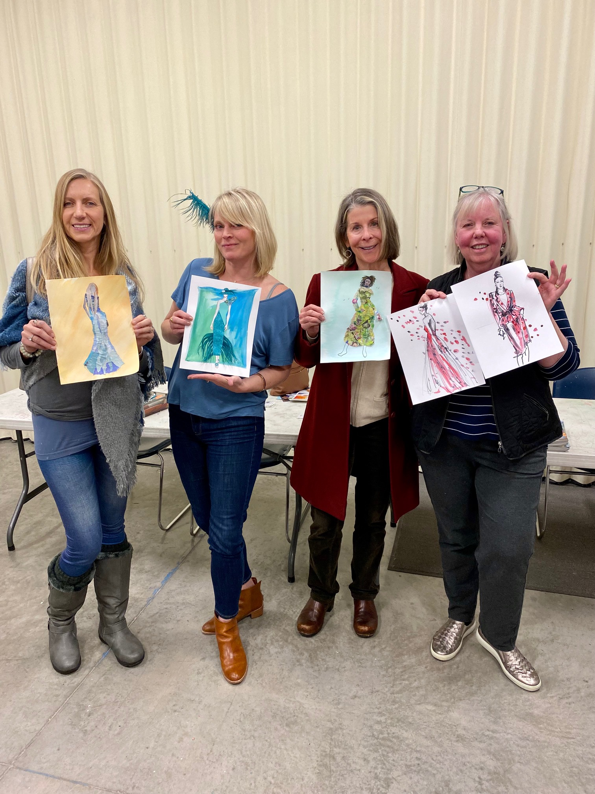

Slide 28
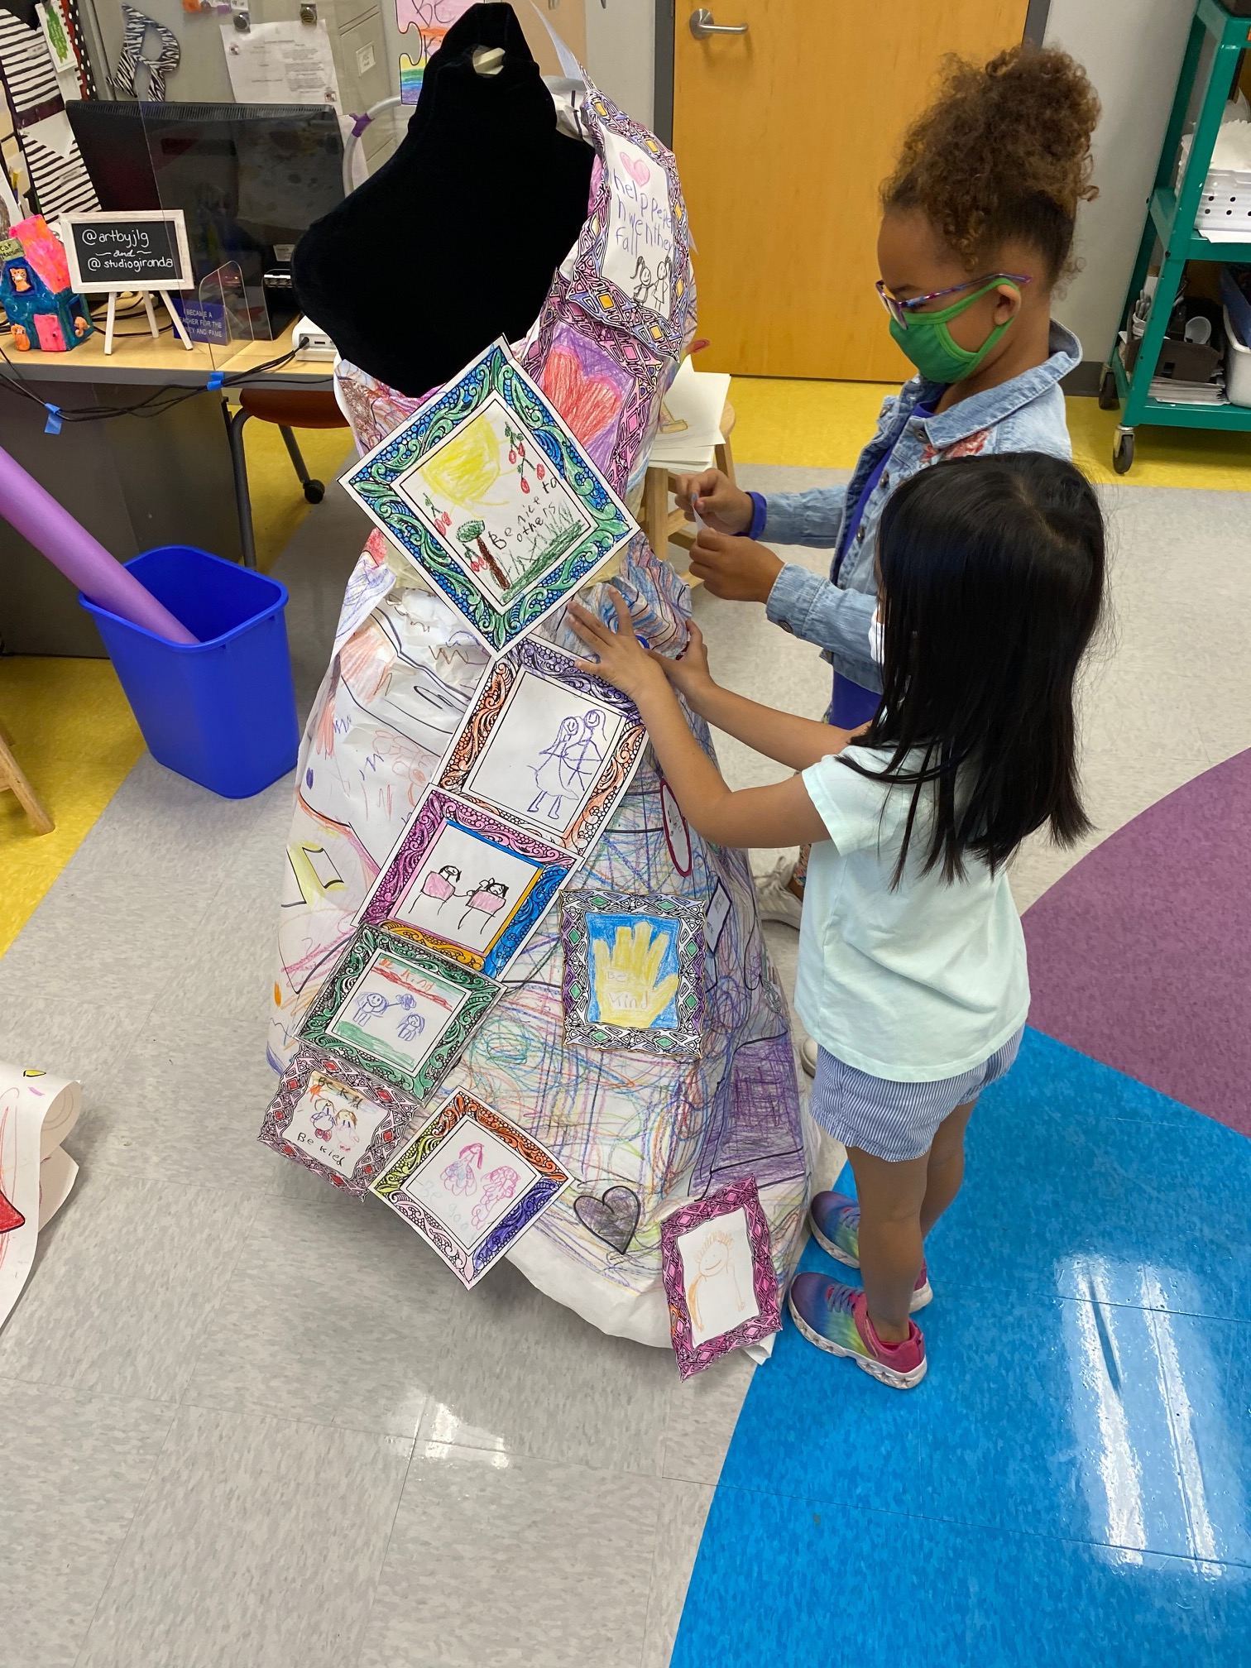
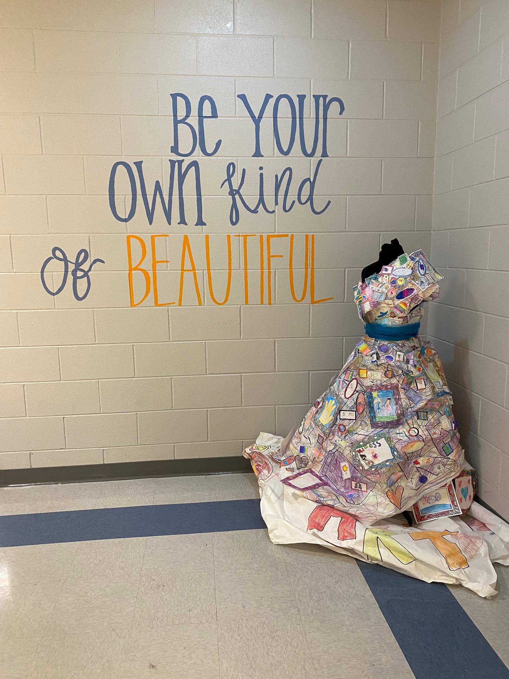

Slide 29
Thank you!
Web: www.jenniferlovegironda.com
Email: jenniferlovegironda@gmail.com
Instagram: @artbyjlg and @studiogironda
Facebook: Jennifer Love Gironda-Art

Slide 30
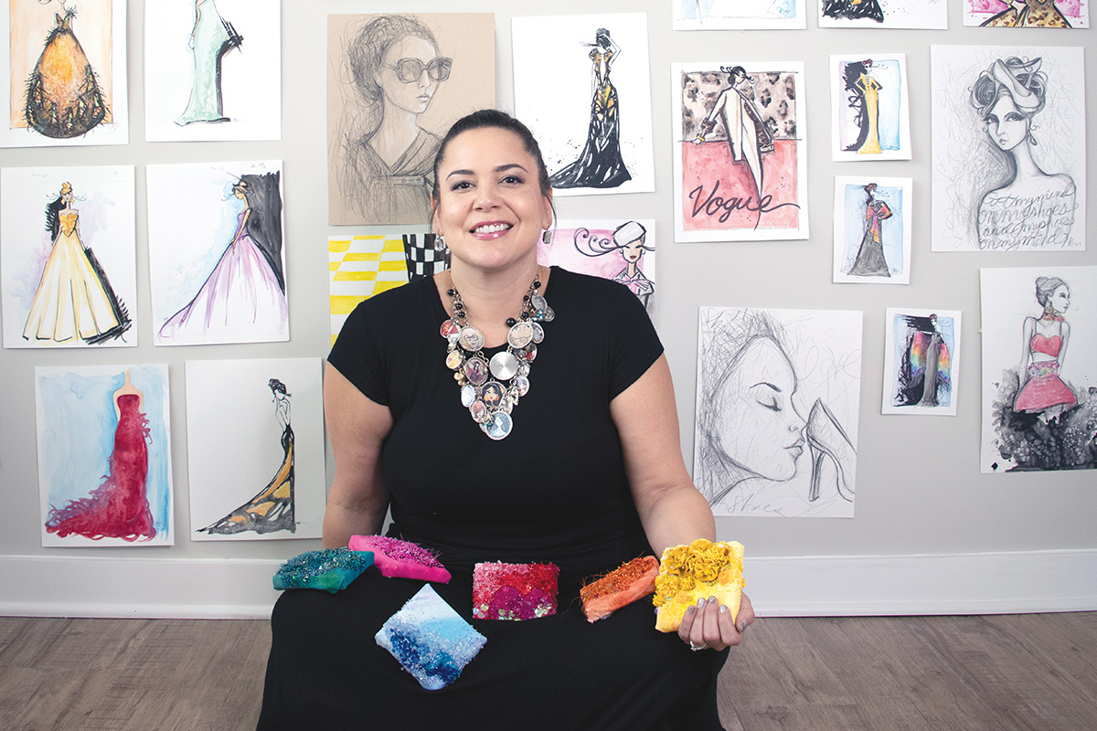
2021 Beaded Pieces on display tomorrow, reception from 5-8pm

